Slide 1
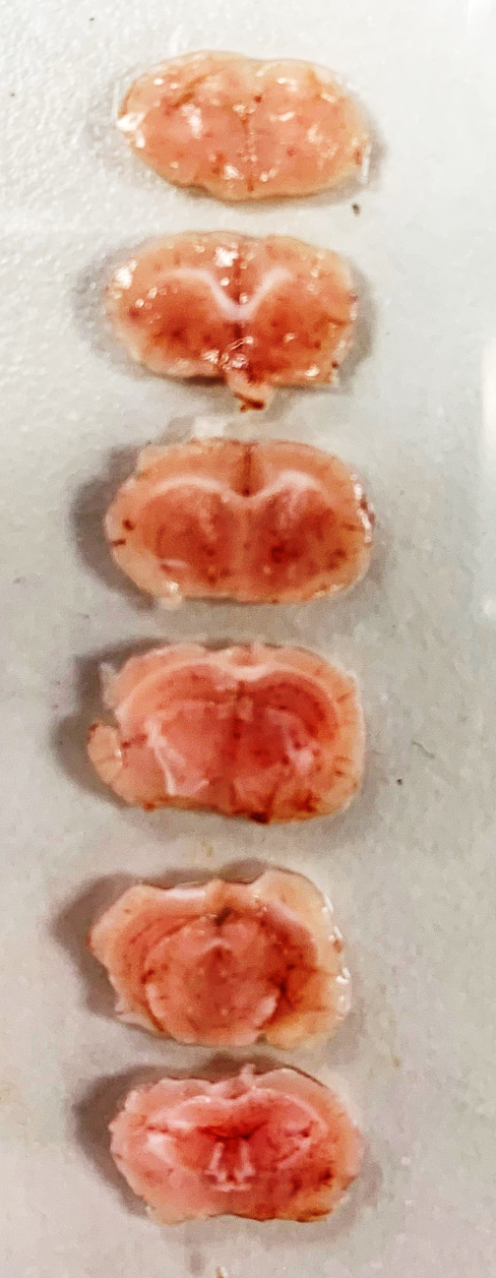
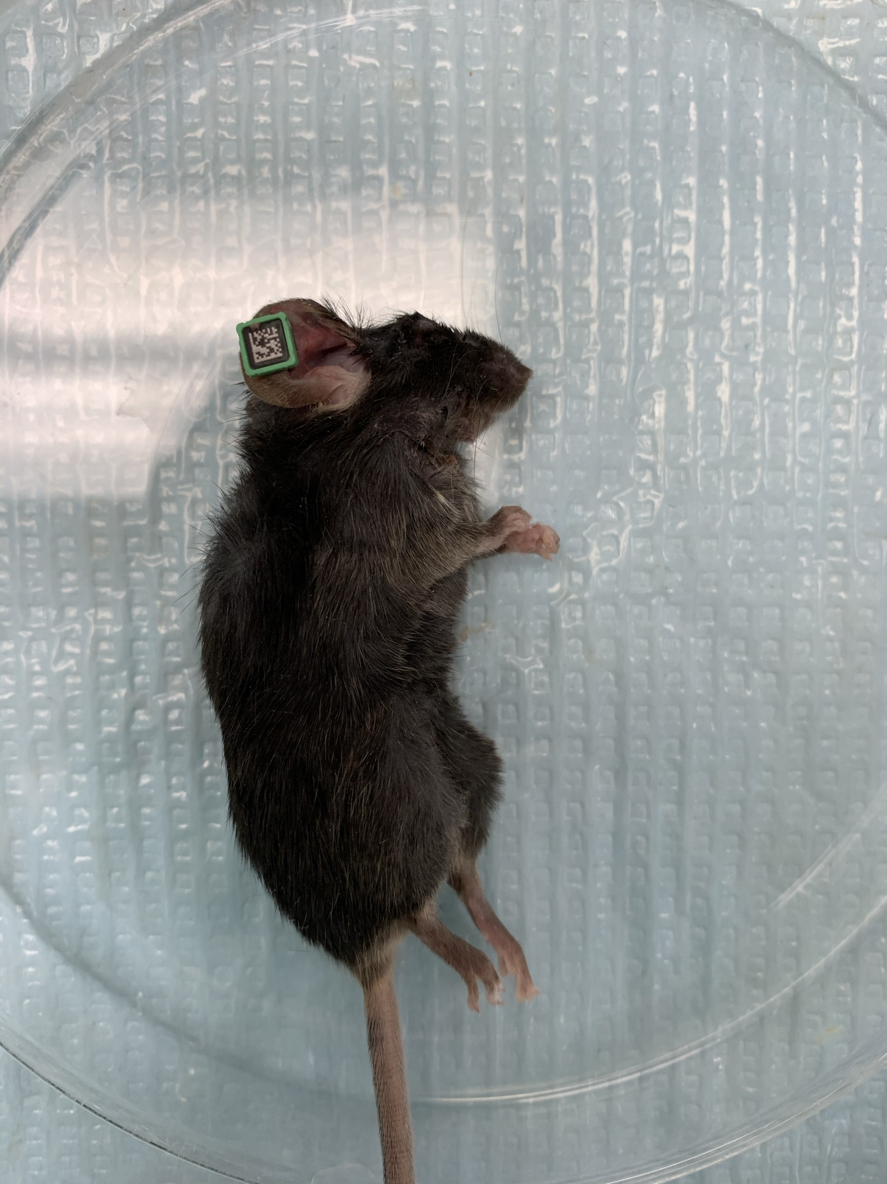
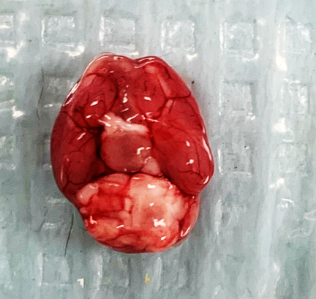
Mouse ID | VH1912
Date of surgery | 11/3/2020
Date of Mortality | 11/10/2020
Day 2 MRI | Yes
Day 7 Behavior | No
Received all the intended treatments | Yes
Visible signs of hemorrhage | No

